Slide 1


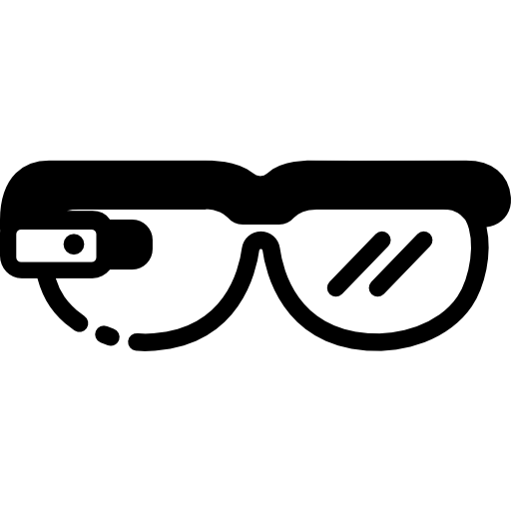
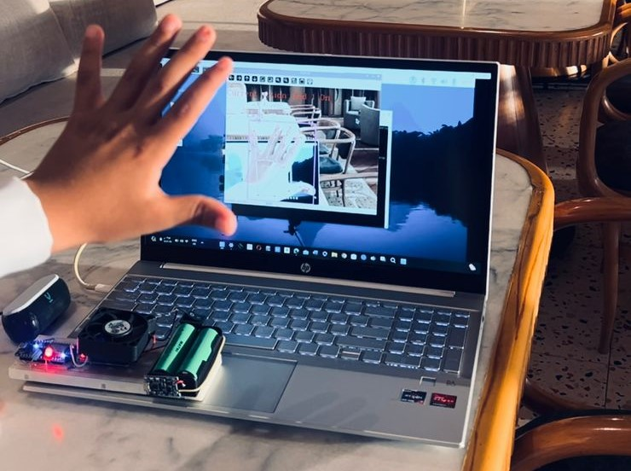
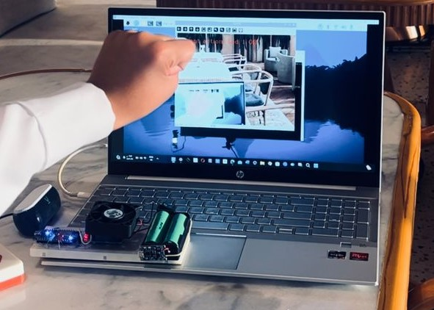
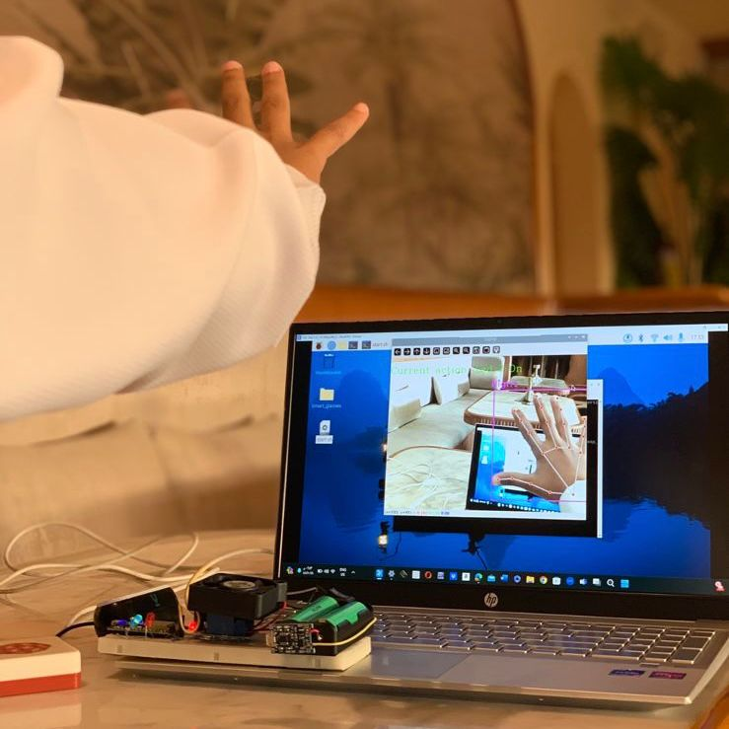
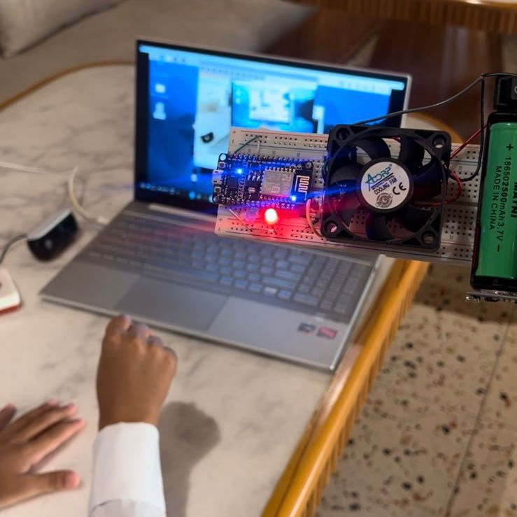
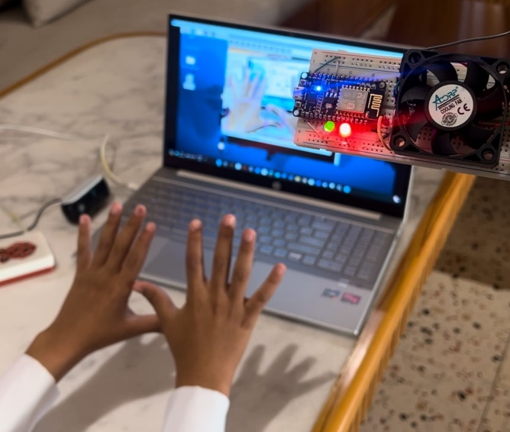
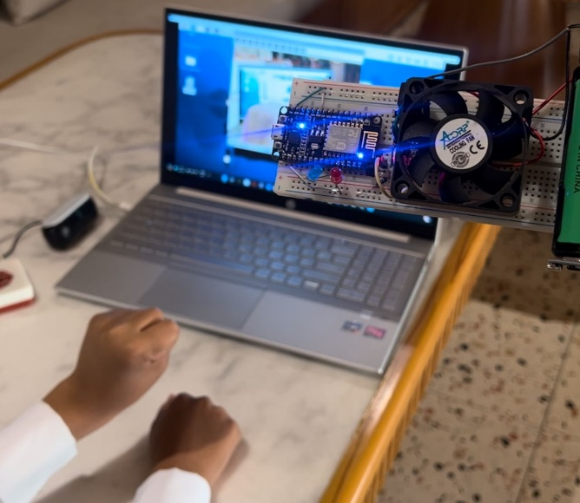
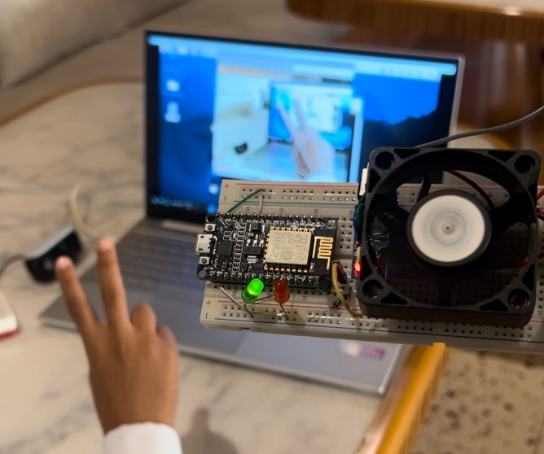
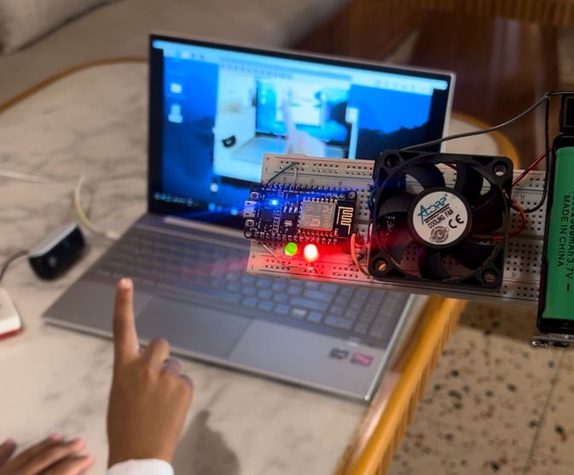
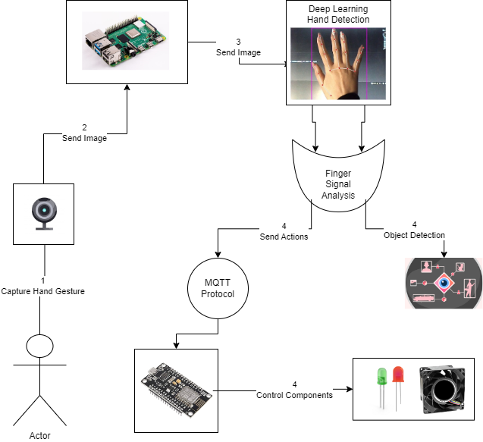
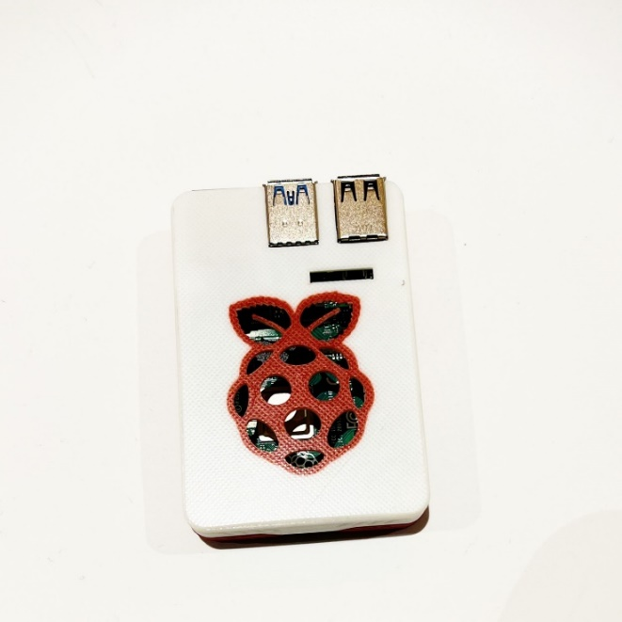
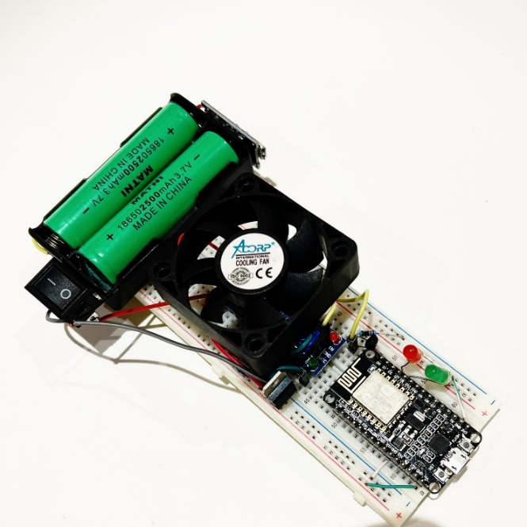
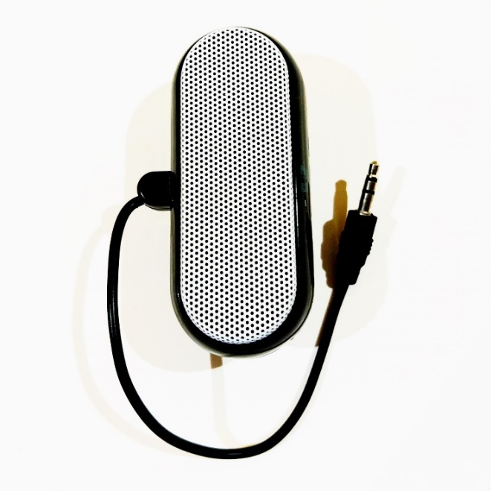
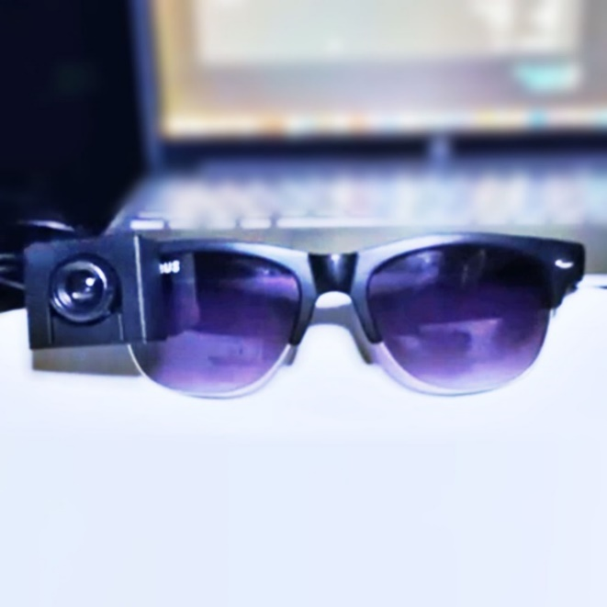
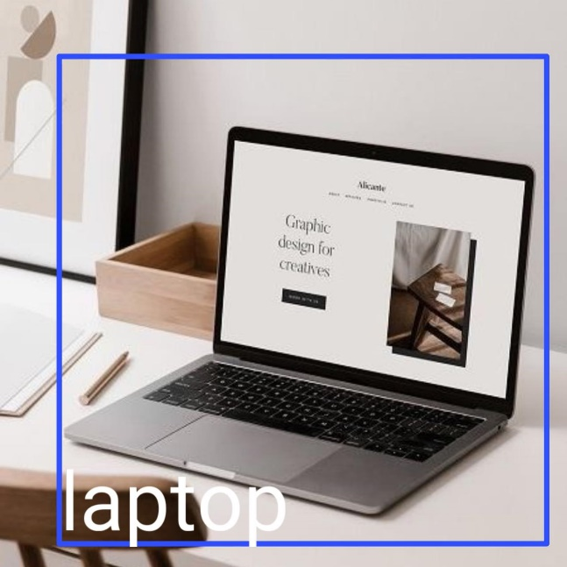
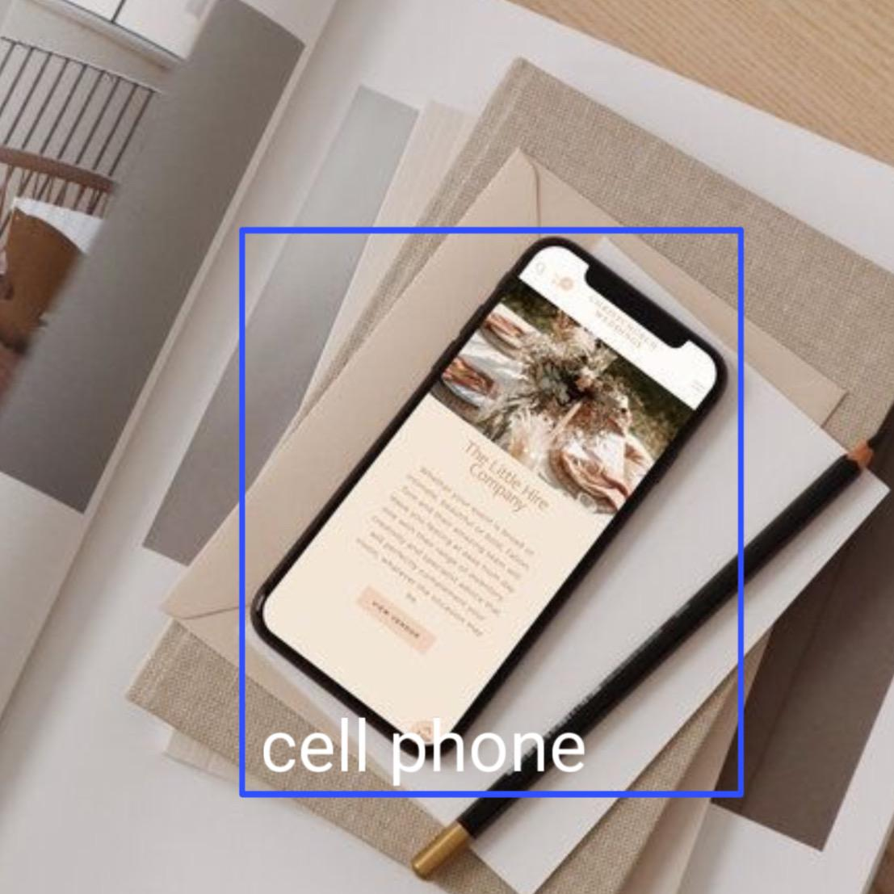
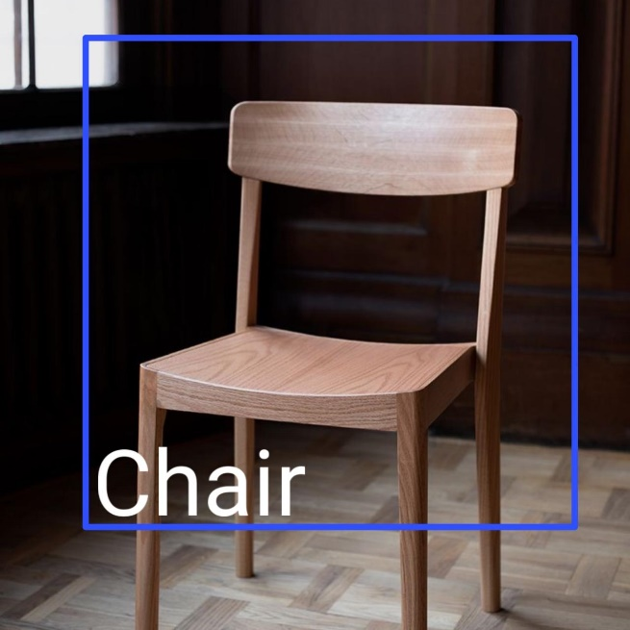
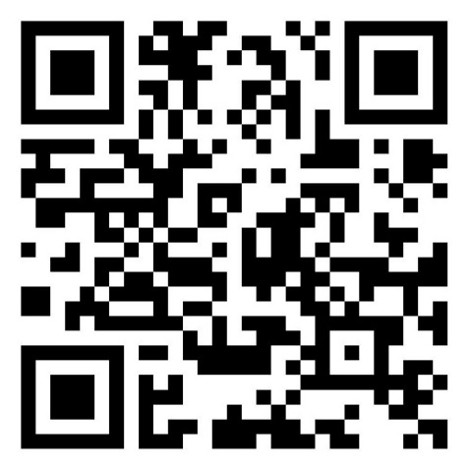
Smart Glasses Remote Control
The College of Computers and Information Technology
Computer Engineering
Supervised by: Dr. Sameer Alsharif – Dr.Rania Mokhtar
Authors:
Shahad Al-jouid - Sara Al-boqami - Hala al-dhais - Razan Al-sawat - Rawan al-Zahrani
Rahaf Al-osimi - Khawlah Al-dosari - Ohoud al-otaibi - Shayma Al -kabi
Abstract
Introduction
The project involves creating smart glasses that are controlled through motion using a camera to track the user's head and hand gestures.
An artificial intelligence algorithm interprets these movements to operate various devices in the user's surroundings, such as lights, appliances, and smart plugs.
The setup operates as a client-server model, where the client resides in the smart glasses and the server in a remote computer. The client collects the user's movements and transmits them to the server, which then interprets these movements to control the smart devices.
The system was developed using Python programming language and MediaPipe framework, which offers hand tracking and gesture recognition functions. To test the system's usability, a user study was conducted, confirming its ease of use.
The project aims to streamline home automation using smart glasses, which interpret hand gestures captured by embedded cameras. Initially, they utilized Google's MediaPipe Hand Detector but faced challenges distinguishing between left and right hands and determining hand proximity. These were addressed through mathematical equations and considerations like hand perimeter and finger positions. Implementation involved Python translation and interfacing with Raspberry Pi and ESP devices for wireless IoT connectivity. The overarching goal is to enhance human interaction without limitations.
Scope
The project focuses on developing motion-controlled smart glasses for managing IoT devices, targeting users interested in hands-free interaction with smart home technology, including IoT enthusiasts and those with mobility challenges. Users can control devices through head and hand movements, facilitated by advanced technologies like cameras and AI. The system operates within a client-server architecture, promoting seamless communication and device control. It aims to enhance convenience and accessibility in smart home environments, with potential applications in healthcare and industry.
Objective
Develop a motion-controlled smart glasses system that utilizes a camera to track the user's head and hand movements.
Implement an artificial intelligence method to interpret the user's movements and enable control of devices within the environment, including lights, appliances, smart plugs, and other smart home devices.
Ensure user-friendly interaction by allowing users to control smart devices simply by moving their heads and hands.
Design the system as a client-server architecture, with the client operating on smart glasses and the server on a remote computer for seamless data transmission and interpretation.
Utilize technologies such as cameras, artificial intelligence algorithms, processing units, and communication units to enable efficient operation of the system.
Results
The experiments showcase the efficacy of hand gesture control for IoT devices, allowing users to trigger actions like turning on/off LEDs or the fan through intuitive gestures. Users can control their environment effortlessly by activating or deactivating IoT devices connected to the ESP based on detected hand gestures and recognized objects, enhancing convenience and accessibility. Object recognition capabilities further improve user interaction by enabling the identification and interaction with surrounding objects.
Led 1 ON Led 1 OFF
Method
The camera, a USB-connected webcam to a Raspberry Pi, captures the image of the hand or the overall frame. This image is then sent to deep learning algorithms equipped with hand detection capabilities. If a hand is detected, we proceed with analysis, gathering comprehensive data about the hand, including each finger and determining if it's the back or front face of the hand. We have two options based on finger signal analysis: either execute the command present within the Raspberry Pi or send a command via the MQTT protocol to the NodeMCU, which then controls the IoT devices.
Led 2 ON Led 2 OFF
All Leds ON All Leds OFF
Fan ON Fan OFF
IoT Device Activation
Object Recognition Samples

